Slide 1




Modern Tech Stack :
The Key to Success in a Data Engineering Career
Aakansha Kandel: Data and Analytics Consultant, FDM Group
4 June 2026
Notes:
Hi everyone, for those of you who don’t know me, my name is Aakansha and I am a data and analytics consultant here at FDM. Today I have put together a presentation to share with you my personal upskilling and why upskilling in tech stack matters.
Which of these technologies do you think is the most important in today's data engineering market: AWS, Snowflake, dbt, or Git?"
Then:
Pause for responses.
Interestingly I have used all of these technologies in my data engineering project.
Because there isn't really a single most important technology. Employers are increasingly looking for people who understand how technologies work together as a tech stack rather than expertise in just one tool. These 4 are amonst the most popular tech stack used.

Slide 2

WHAT’S IN IT FOR YOU?
Data Engineering Concepts
  Stronger Employability
  Tech Stack
Notes:
"So how will this presentation help you today?
First, you'll gain exposure to technologies that are commonly used in modern data engineering teams.
Second, you'll see how modern data pipelines are built using real-world data engineering concepts
And, you'll gain some ideas for your own upskilling journey and the types of projects that can help you stand out, and increase your employability in today’s competitive market.

Slide 3

WHY DATA ENGINEERING MATTERS
Organisations generate large volumes of data every day
Transform data and make it ready for reporting
Medallion architecture is very popular for this
Notes:
"I am just going to start by reminding you all why data engineering matters. Organizations generate large volumes of data every day — often incomplete and spread across multiple systems. Next, data engineering transforms that data into something trusted for reporting and decision-making, Next In modern data engineering, the medallion architecture is very popular, which I will explain to you later.
4 months ago, many of these technologies were completely new to me as well, but I have quickly learnt them and enjoyed the process.
Right now, dbt and Snowflake skills are in high demand but relatively rare — most young developers like us haven't learned them yet. That window won't stay open. In two years this will be a requirement, not a differentiator. The people who learn it now get the advantage."

Slide 4
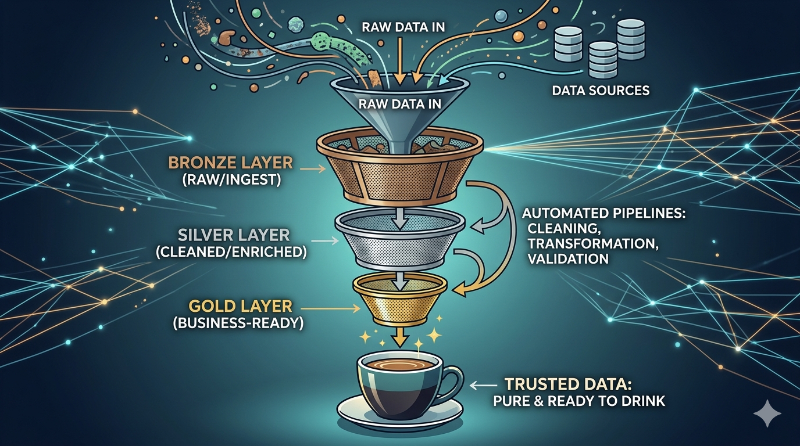
WHAT IS MEDALLION ARCHITECTURE
Notes:
One of the most widely adopted approaches used in modern data engineering ad I mentioned previously is the Medallion Architecture, which is the architecture I used for this project.
Think of Medallion Architecture like a coffee filter. Raw data goes in dirty at the top — Bronze. It gets filtered and cleaned and transformed— Silver. What comes out the bottom is curated ready to drink data — Gold. The data from this gold layer has been curated and dimensionally modelled this to be used by business analysts. The Medallion architecture is what organisations like Shell, HSBC and H&M are running their entire data operations on.
Thsi is not just an option concept. IT’s being used by some of the world's largest organisation, so its very important for us as young IT graduate, to enter the workforce with awareness of concepts such as medallion architecture.

Slide 5
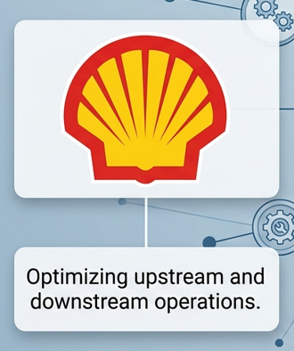

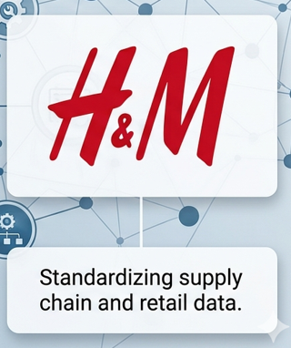
MAJOR ORGANISATIONS ARE RUNNING THEIR DATA PIPELINES ON MEDALLION ARCHITECTURE
Notes:
The Medallion architecture is what organisations like Shell, use for optimising upstream and downstream operations, HSBC to drive global financial data analytics and H and M: Standardizing supply chain and retail data. and H&M are running their entire data operations on.
Thsi is not just an option concept. IT’s being used by some of the world's largest organisation, so its very important for us as young IT graduate, to enter the workforce with awareness of concepts such as medallion architecture.

Slide 6
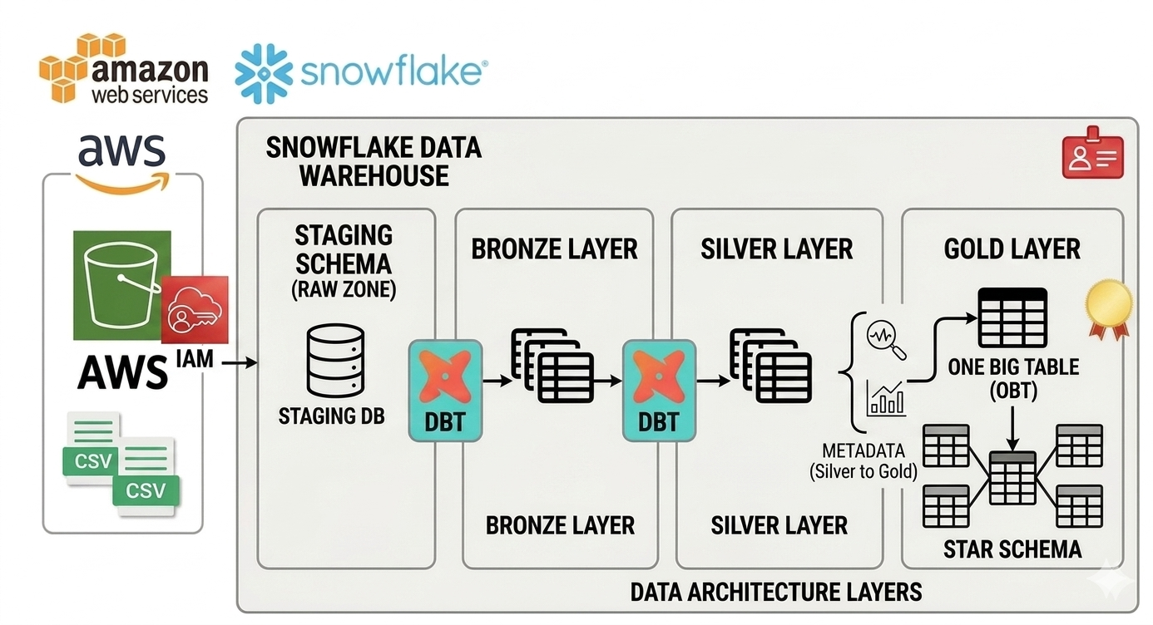

PROJECT ARCHITECTURE
Notes:
Time to show the project architecture of my project, and surprisingly I actually really enjoyed building it.
I used an Airbnb dataset consisting of listings, hosts and bookings. In a real business, these could represent data coming from property management systems, customer systems and booking transaction systems.
The entire solution is version controlled using Git and developed using dbt models, where transformations and configurations using Jinja SQL(a type of coding language). Snowflake acts as the data warehouse, where dbt loads the data.
Firstly, The raw CSV files are stored in AWS S3, which acts as the data lake. Snowflake then accesses this data using AWS IAM.
I also created a user on dbt to give it access to my snowflake account. So it creates the bronze, silver and gold schemas in Snowflake and loads data using dbt.
As seen in this diagram, dbt gets access to the staging schema on Snwoflake and loads raw data from the staging schema into the Bronze schema in Snowflake, then from Bronze into the Silver schema in snowflake(remeber silver is where data is transformed, such as aggregated, rated), and finally into the Gold schema in snowflake. The bronze and Silver layer use the incremental and upsert logic to update new or changed data.
In the Gold layer, I created both a One Big Table for simple reporting and a Star Schema using fact and dimension tables for scalable analytics. ---add humanizing comments to this
Quick show of hands: how many of you have used metadata to drive transformations in a data pipeline?
f you see a lot of hands:
"That's great. You'll know that metadata-driven design can make pipelines much easier to maintain and scale as requirements change."
If you see only a few hands or none:
"Not many, which is completely fine. Before building this project, I hadn't used metadata in this way either. today you’ll know why it's such a powerful design pattern."
•Metadata is used to drive the Silver-to-Gold transformation. Instead of hardcoding table names, columns, and joins. I stored this information as metadata. This allows dbt to dynamically generate transformations, making the pipeline more scalable, reusable and easier to maintain as requirements change. This concept is widely used across data engineering industries. To drive the staging to bronze and bronze to silver transformation, I implemented incremental load and upsert.

Slide 7
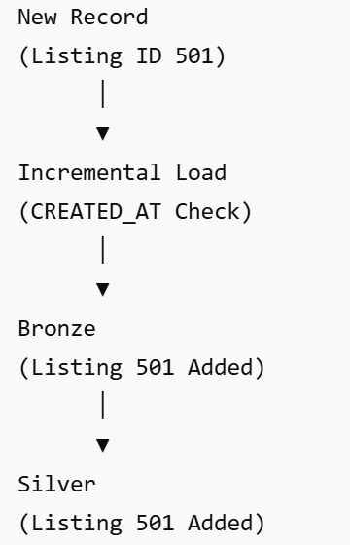
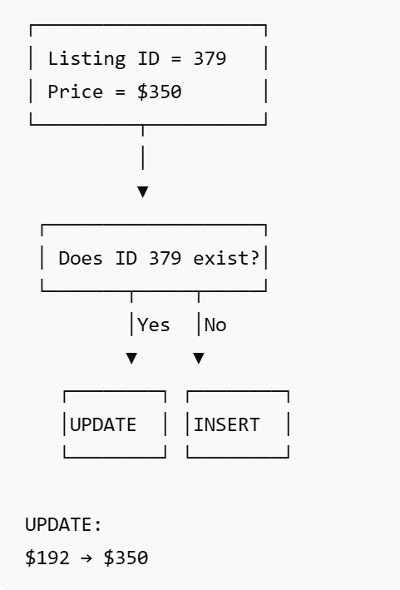
INCREMENTAL LOAD AND UPSERT
Incremental Load: Insert new rows
Upsert: Update and Insert
Notes:
As I mentioned previously data in bronze and silver layer uses incremental method so that any new updated data is automatically loaded once the pipeline runs again, and silver to gold implements the metadata driven logic.
Incremental load is where •dbt checks the latest CREATED_AT value already stored in the target table and only loads records newer than that timestamp, so any new created listing record, we will add a new row 501 in our staging schema, dbt will check timestamp and load the new row across all of the bronze silver and gold layers.
Upsert means update if the record already exists otherwise insert a new row. This is often done by adding a unique key, when materializing the flow as incremental. I will be showing this in my demo: we will change the “price_per_night for lisitng ID 379 to 350” in our staging schema and this will get updated across all layers when the pipeline runs.
These are applied for tables in bronze and silver layer, so that if any changes to data in either staging or bronze layer, it gets updated, then gold layer uses the metadata from the silver layer to generate the fact and dimension tables and one big table

Slide 8
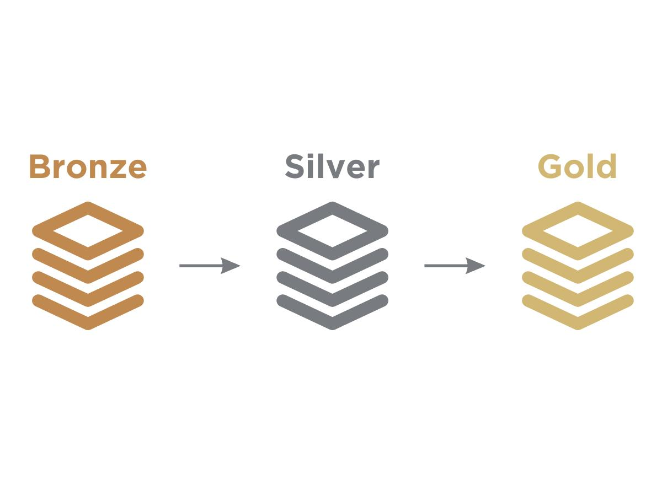
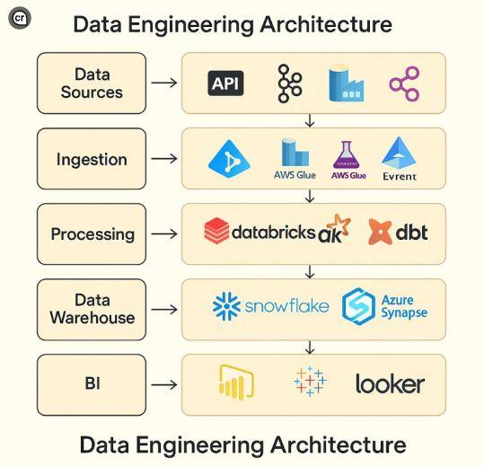



KEY TAKEAWAYS
2. Focus on concepts, not just technology
3. Build industry level projects
Technology stacks matter.
Notes:
"I'd like to finish with three key takeaways.
1. Technology stacks matter.
Talend, Snowflake and AWS are another popular set of tech stack
2.
. Focus on concepts, not just technology
Data modelling, Medallion architecture, incremental and upsert logic, because technologies change , but core concepts remain valuable
3. Build industry level projects - they provide practical experience and reflect how modern data teams operate

Slide 9
THE IMPORTANCE OF UPSKILLING
Imagine yourself two years from now applying for a data engineering role. Which sounds stronger in an interview:
'I've heard of AWS and Snowflake.’
Or
'I've built a working project using AWS, Snowflake, dbt and Git.'
Notes:
Imagine yourself t applying for a data engineering role tommorrow. Which sounds stronger in an interview:
'I've heard of AWS and Snowflake.'
Or
'I've built a working project using AWS, Snowflake, dbt and Git.'
Pause.
The answer is quite obvious:- it’s the second, option because the second person get’s the job and
I want you all to be the second person, so advise you to upskill in this tech stack or another one.
So start upskilling. here is the link in the chat.

Slide 10
Thank you!
Aakansha Kandel – Data and Analytics Consultant at FDM Group

